Slide 1


^{Assignment for Internship}

Slide 2
Assignment Guidelines
Try to write your own code on your own. We will be discussing the code in the follow up interview.
You can use all the resources available to you over internet for reference, but when you use the same be aware of why it can be used in your code.
Try to finish as much as possible.

Slide 3
Exercise for implementation
Goal : Develop a simple django application to see the shopify merchant sales data
Explanation :
Develop a django application which connects to the API of Shopify and pull a merchant’s sales data and shows the daily sales data in a chart and tabular format in your django application
The example screen is given in next slide

Slide 4
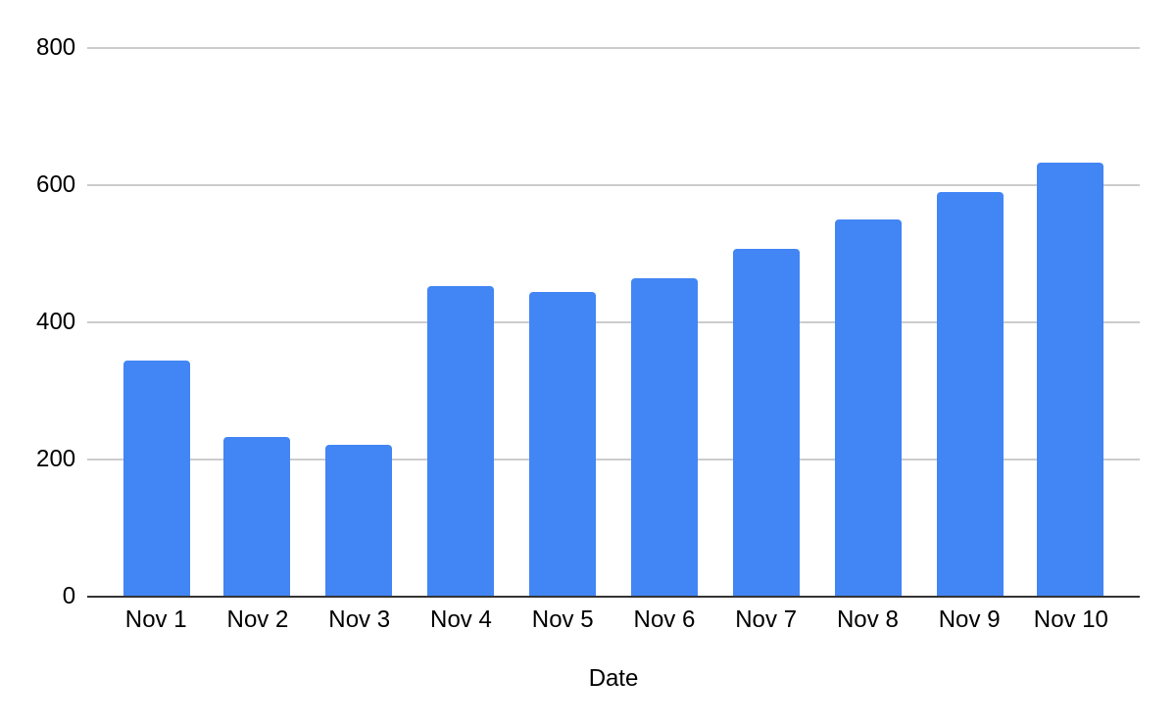
Logout
Shop Name : ___________
Daily sales data
Date | Nov 1 | Nov 2 | Nov 3 | Nov 4 | Nov 5 | Nov 6 | Nov 7 | Nov 8 | Nov 9 | Nov 10
Daily Sales | 343 | 232 | 222 | 453 | 443 | 465 | 507 | 549 | 591 | 633

Slide 5
Details & way to approach
Install Django, understand the components of model, view and template parts of the Django. Don't try to master django. Just try to learn the basics and try to execute the given problem statement.
Check out shopify developer portal ( https://shopify.dev/) and APIs provided by them. You would require to use python based api as we use python/django.
In Shopify Developer portal, register yourself as developer and create an account. You will get access to the APIs.
Identify the sales APIs and pull the data - Last 3 months - and store in the data in DB of Django.
Now in the django application, in frontend, try to render the data regarding last 7 days in chart using Chart JS library and tabular format as given in previous slide

Slide 6
Evaluation Criterias
The primary goal is to assess how much the candidate is able to handle new / different kind of libraries and frameworks.
You may not be able complete full assignment, but try to prorotise key elements of the assignment like API access and storing the data in Django web framework
Quality and functionality of the developed app
Adherence to the Django stack and best coding practices
Effectiveness in integrating Shopify API
Note : Keep pushing the code in a private git repo regarding the evaluation.

Slide 7
We build data applications with focus on accuracy to improve productivity and decision making process.
Thank you

